Slide 19
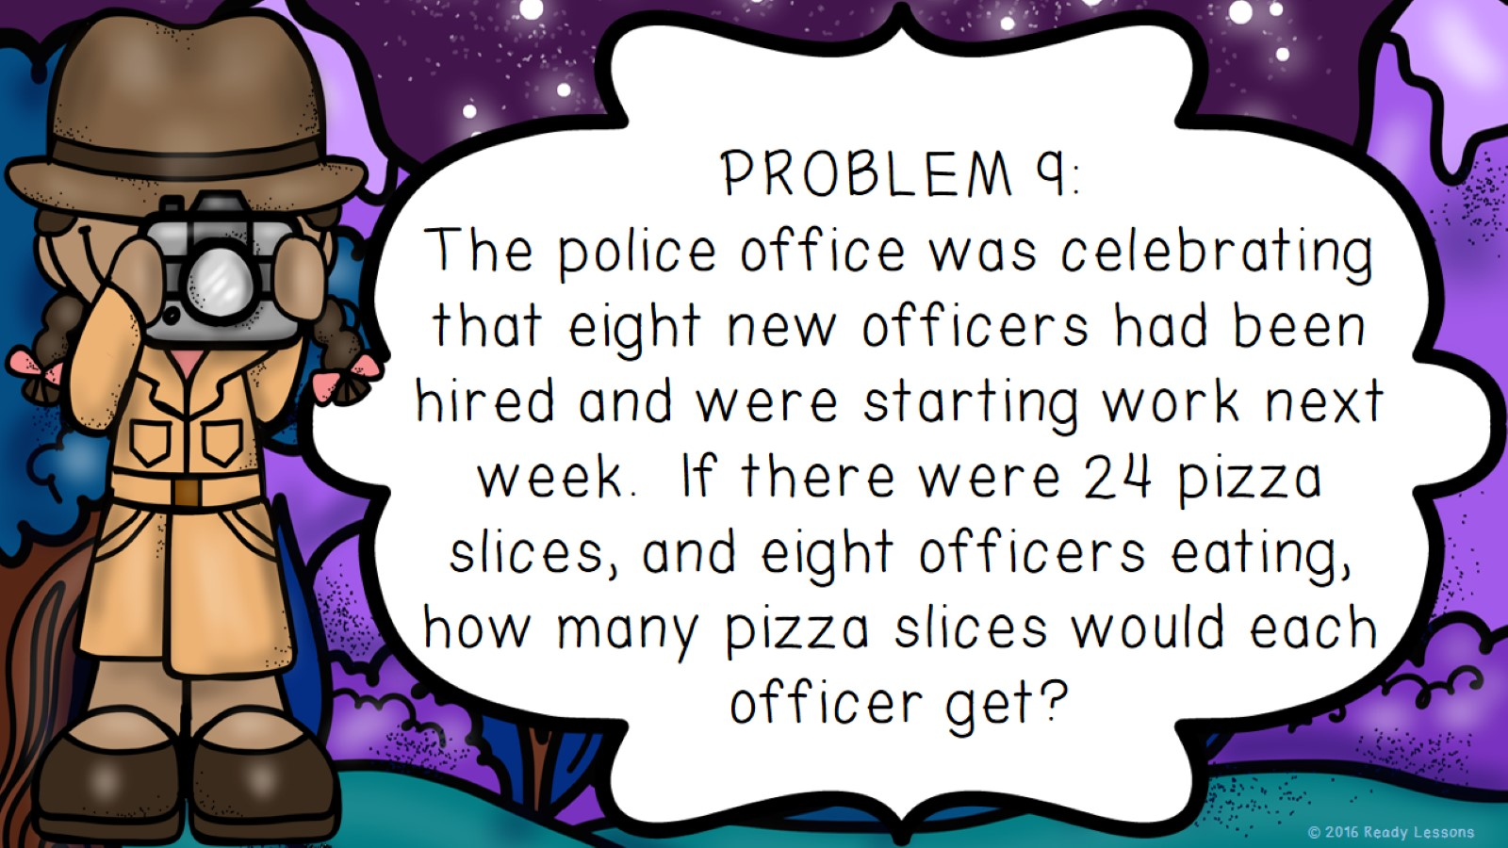

Slide 23
http://www.teacherspayteachers.com/Store/Ready-Lessons

Slide 24
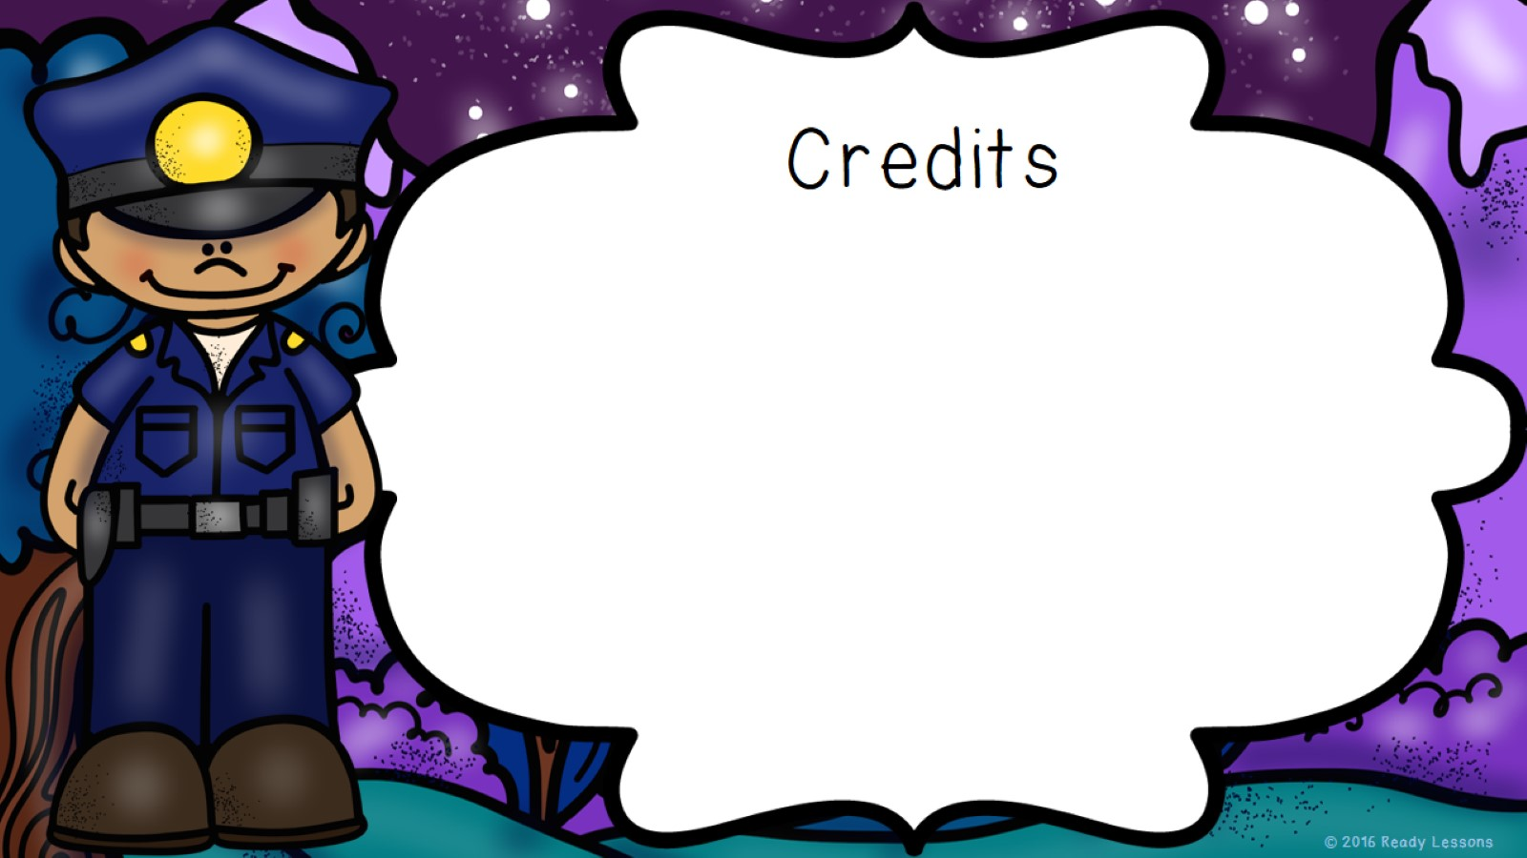
Educlips
http://www.edu-clips.com
I’m Lovin’ Lit
http://imlovinlit.com/

