Slide 1
Get your swimming gear on… We are going to
DIVE INTO LEARNING
WITH THE COMMUTATIVE PROPERTY!

Slide 2
Learning Target:
I can apply the commutative property of multiplication to help me multiply.

Slide 3
Table Talk Time!
Let’s Review some
MULTIPLICATION MATH VOCABULARY:
What are factors?
What is a product?

Slide 4
SPLASH! RIGHT ON...
FACTORS are the numbers you multiply to get the PRODUCT(the answer to a multiplication equation).
For example:
3 X 8 = 24
PRODUCT
FACTORS

Slide 5
So let’s think about this- Finish this sentence
The commutative property is….
__________________________________
________________________________
*Hint- Here is an example of the property in ACTION:
2 X 4 = 4 X 2
when you change the order of the factors in a
multiplication problem and get the same answer.

Slide 6
The commutative property involves “flip flopping”
the factors to get the same product.
So let’s put our FLIP FLOPS into action!
Try this 1:
Four rows of five
4 X 5 = 20
5 X 4
4 X 5
Fives rows of four
5 X 4 = 20
The evidence supports the commutative property
that 5 X 4 and 4 X 5 both equal 20!

Slide 7
Try this 2:
Does 1 X 7 = 7 X 1 ?
Seven rows of One
7 X 1 = 7
One row of Seven
1 X 7 = 7
1 X 7
7 X 1
The evidence supports the commutative property
That 1 X 7 = 7 X 1. They both equal 7!

Slide 8
Try this 3:
Does 7 X 6 = 6 X 7 ?
Six rows of seven
6 X 7 = 42
7 X 6
6 X 7
Seven rows of six
7 X 6 = 42
The evidence supports the commutative property
That 7 X 6 = 6 X 7. They both equal 42!

Slide 9
Try this 4:
Does 2 X 3 = 3 X 2 ?
Three rows of Two
3 X 2 = 6
Two rows of Three
2 X 3 = 6
2 X 3
3 X 2
The evidence supports the commutative property
That 2 X 3 = 3 X 2. They both equal 6!

Slide 10
NOW YOUR TURN…
Find the missing factor in the following problems.
READY, SET, DIVE
into what you have learned
to catch the correct answer!

Slide 11
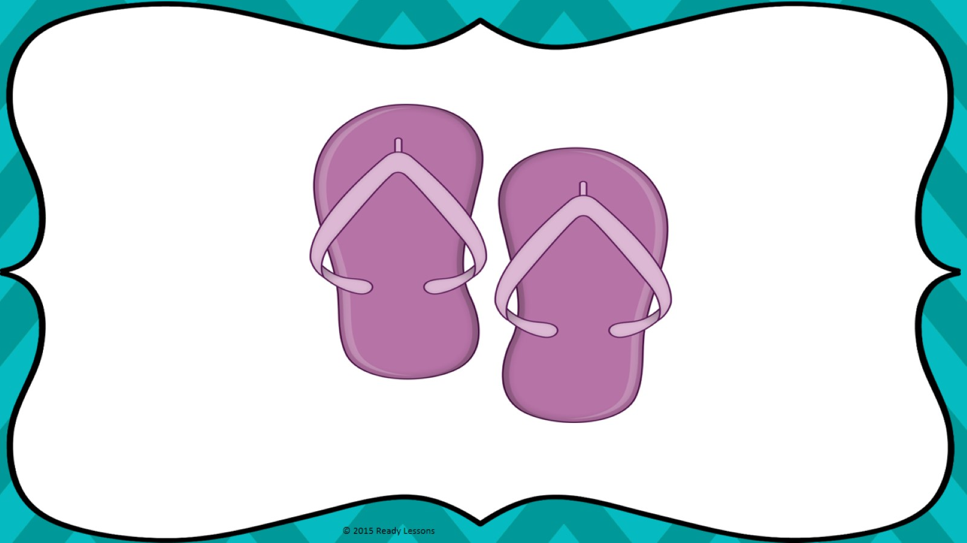
3
Fill in the Blank: 5 X 3 = ___ X 5 ?
Three rows of five
3 X 5 = 15
5 X 3
Five rows of three
5 X 3 = 15
? X 5
The answer is 3, I know this because 3 x 5 is fifteen. I used arrays and fact families to help me!

Slide 12
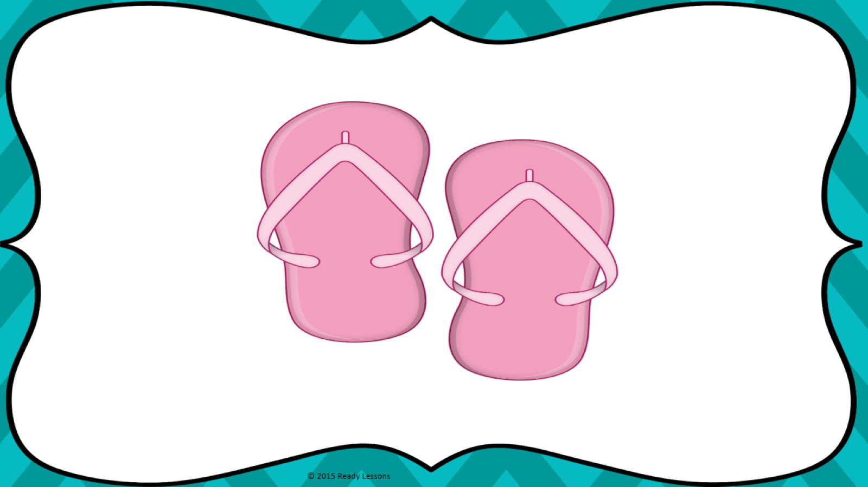
4
Fill in the Blank: 8 X 4 = ___ X 8 ?
8 rows of 4
8 X 4 = 32
8 X 4
? X 8
4 rows of 8
4 X 8 = 32
The answer is 4, I know this because 4 x 8 is thirty-two. I used arrays and fact families to help me!

Slide 13
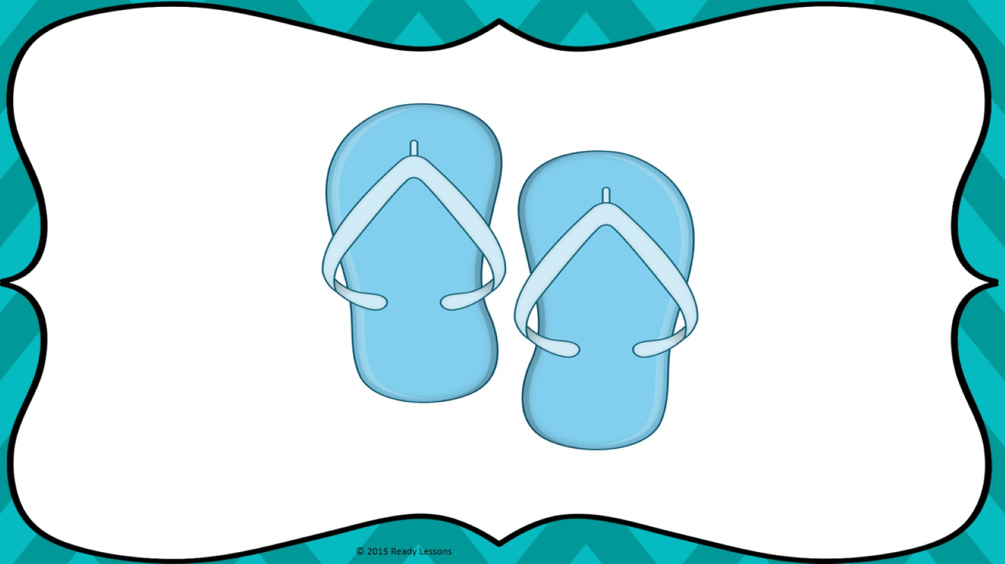
9
Fill in the Blank: 2 X 9 = ___ X 2 ?
Nine rows of two
9 X 2 = 18
Two rows of nine
2 X 9 = 18
2 X 9
? X 2
The answer is 9, I know this because 9 x 2 is eighteen. I used arrays and fact families to help me!

Slide 14
4
Fill in the Blank: 6 X 4 = ___ X 6 ?
4 rows of 6
4 X 6 = 24
6 X 4
Six rows of four
6 X 4 = 24
? X 6
The answer is 4, I know this because 4 x 6 is twenty-four. I used arrays and fact families to help me!

Slide 15
REMINDER:
JUST FLIP THE FACTS!
KEEP ON FLIP FLOPPING THE
FACT FAMILIES!
6 X 3 = 3 X 6
9 X 8 = 8 X 9

Slide 16
Quick Check Time:
Show what you know
True or False

Slide 17
6 X 4 = 7 X 4
or
24 = 28
True
False

Slide 18
6 X 2 = 2 X 6
or
12 = 12
True
False

Slide 19
7 X 3 = 7 X 7
or
21 = 49
True
False

Slide 20
6 X 9 = 6 X 6
or
54 = 36
True
False

Slide 21
5 X 8 = 8 X 5
or
40 = 40
True
False

Slide 22
Thank You Thank you for purchasing this product. To see more of my products please visit my Teachers Pay Teachers Store at http://www.teacherspayteachers.com/Store/Ready-Lessons The purchaser of the license may use this product for personal use and for their own classroom only.

Slide 23
Credits
Heather Ayers, Fun for Learning
http://www.teacherspayteachers.com/Store/Fun-For-Learning

