Slide 28
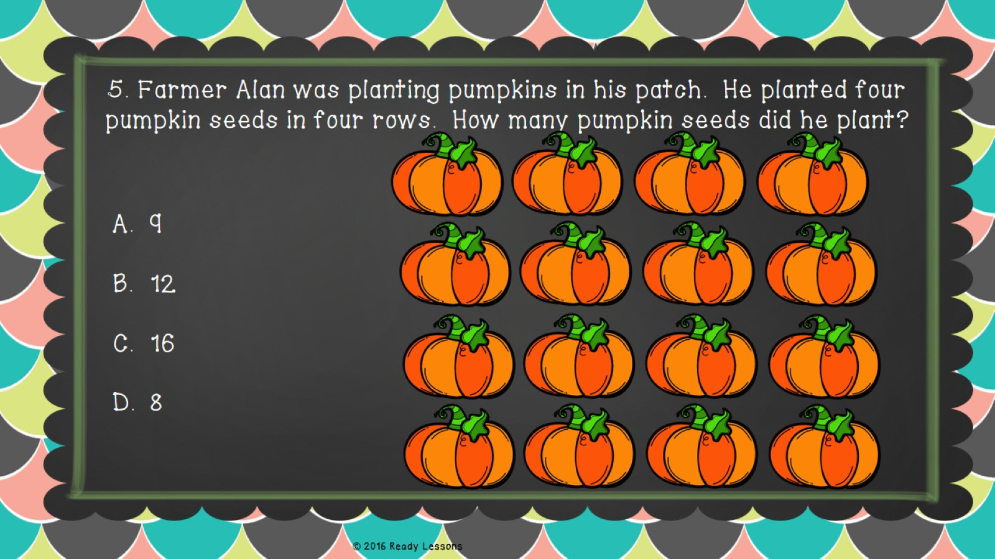

Slide 29
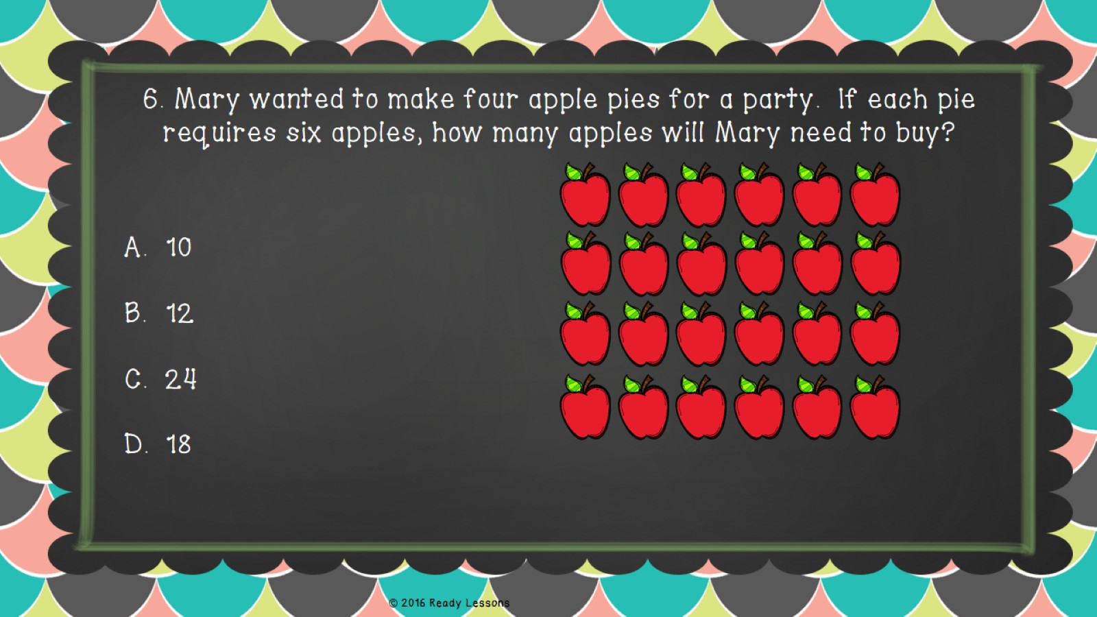

Slide 65
http://www.teacherspayteachers.com/Store/Ready-Lessons

Slide 66
I’m Lovin’ Lit
http://imlovinlit.blogspot.com
Creative Clips by Krista Wallden
http://www.teacherspayteachers.com/Store/Krista-Wallden
Heather Ayers, Fun for Learning
http://www.teacherspayteachers.com/Store/Fun-For-Learning
This document was created using licensed graphics from Glitter Meets Glue Designs. It is a violation of copyright law to “lift” the graphics for other purposes. To obtain your own license, visit http://glittermeetsglue.com/

