Slide 43
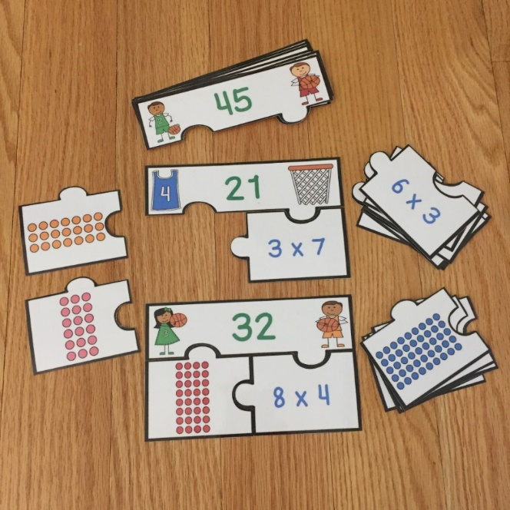
Free Multiplication Array Puzzles
Click here to get them now!

Slide 44
http://www.teacherspayteachers.com/Store/Ready-Lessons

Slide 45
I’m Lovin’ Lit
http://imlovinlit.blogspot.com
Trioriginals http://www.teacherspayteachers.com/Store/Trioriginals
Nastaran
https://www.teacherspayteachers.com/Store/Nastaran
The Wise Old Teacher
https://www.teacherspayteachers.com/Store/The-Wise-Old-Teacher
Graphics by Poppydreamz Digital Art found on Teachers Pay Teachers @
https://www.teacherspayteachers.com/Store/Poppydreamz-Digital-Art
Some or all of the graphics in this presentation came from Poppydreamz Digital Art.
It is a violation of copyright laws to remove the graphics
from this presentation for other uses.
If you wish to use these graphics for yourself,
you can find them by visiting Poppydreamz Digital Art at
http://www.poppydreamzdigitalart.blogspot.com

