Slide 32
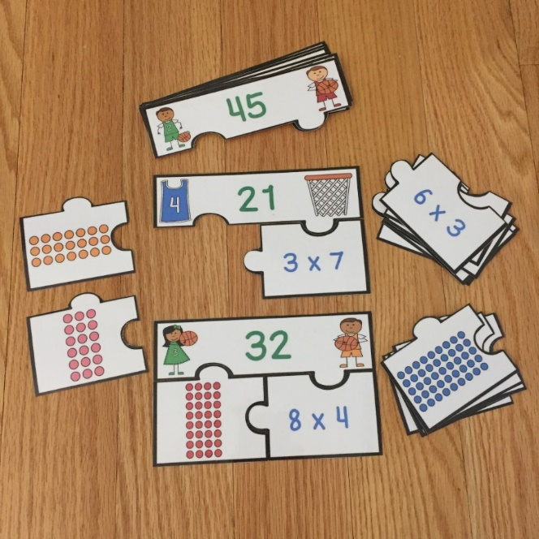
Free Multiplication Array Puzzles
Click here to get them now!

Slide 33
http://www.teacherspayteachers.com/Store/Ready-Lessons

Slide 34
I’m Lovin’ Lit
http://imlovinlit.blogspot.com
Creative Clips by Krista Wallden
http://www.teacherspayteachers.com/Store/Krista-Wallden
Educlips
http://www.edu-clips.com
Laura Martinez
http://www.teacherspayteachers.com/Store/Teacher-Laura
Digital Classroom Clipart
www.digitalclassroomclipart.com

